Slide 1
Decision Tree Classification Algorithm

Slide 2
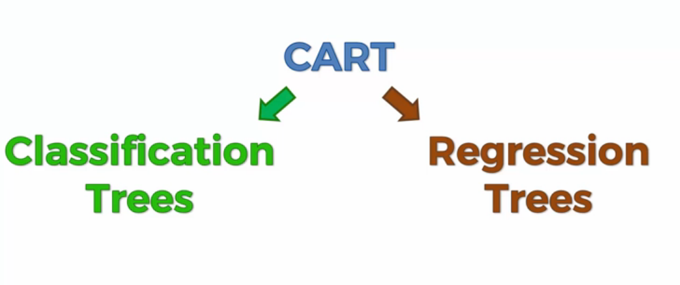
CART (Classification And Regression Trees)

Slide 3
Classification trees
Helps you classify your data
Work mostly on categorical values
Regression trees
Designed to help you predict articles which can be real numbers

Slide 4
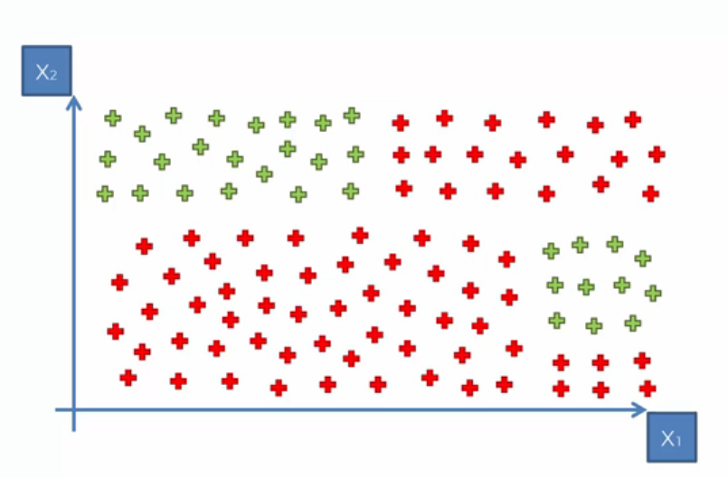
Classification Trees

Slide 5
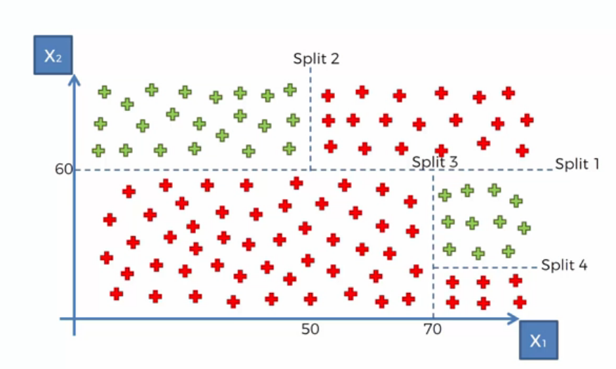
Classification Trees

Slide 6
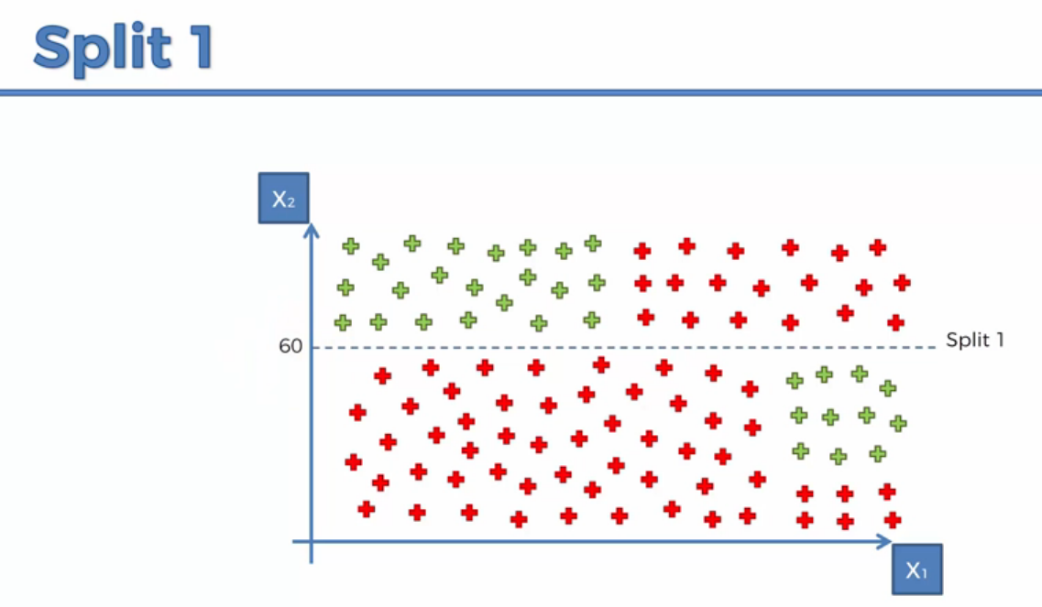
Classification Trees

Slide 7
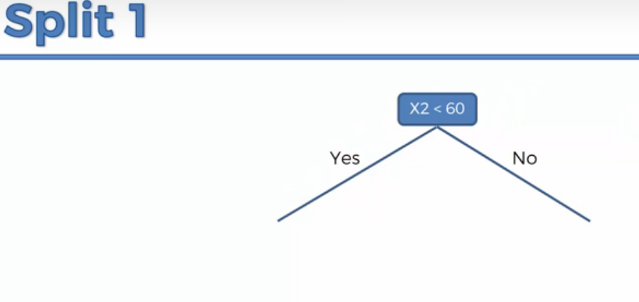
Classification Trees

Slide 8
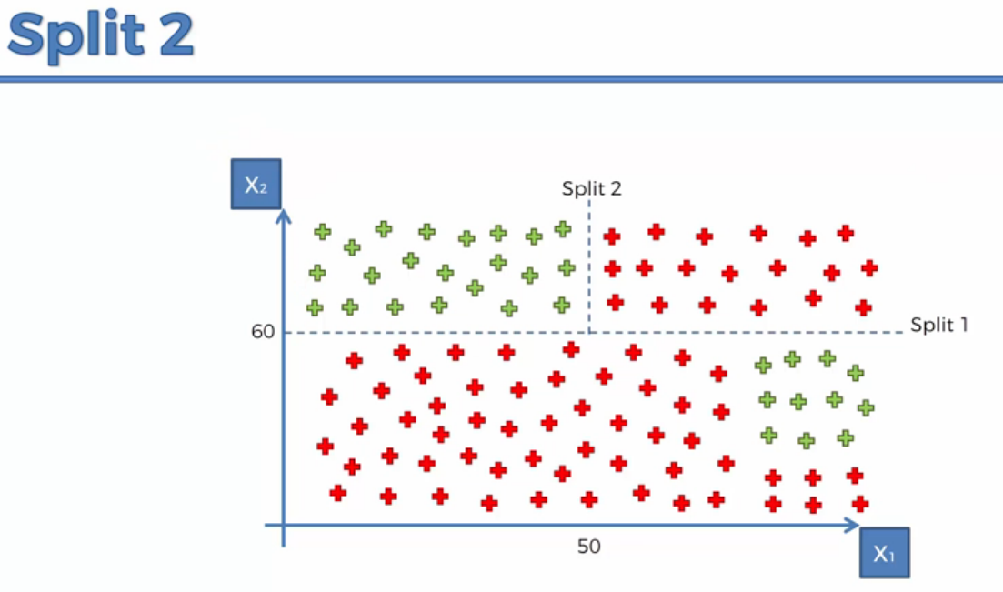
Classification Trees

Slide 9
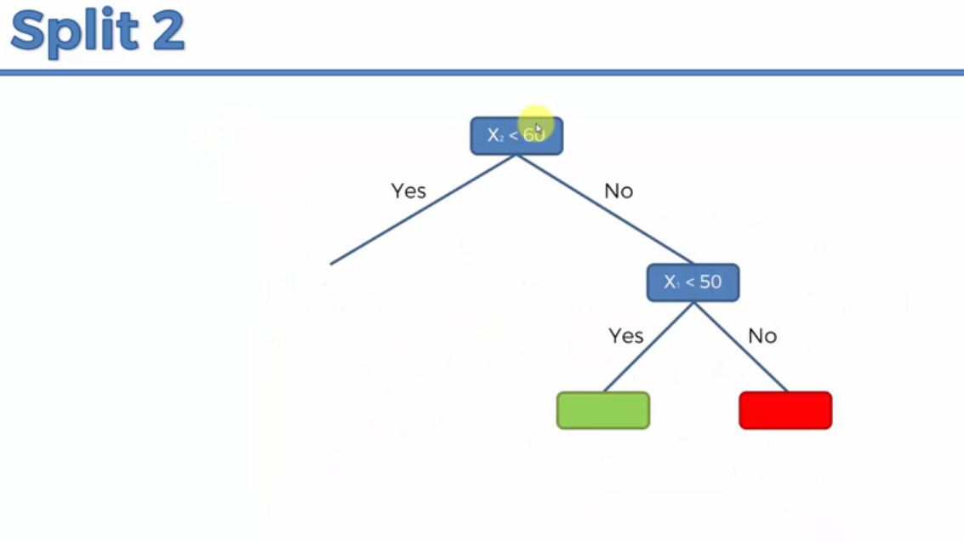
Classification Trees

Slide 10
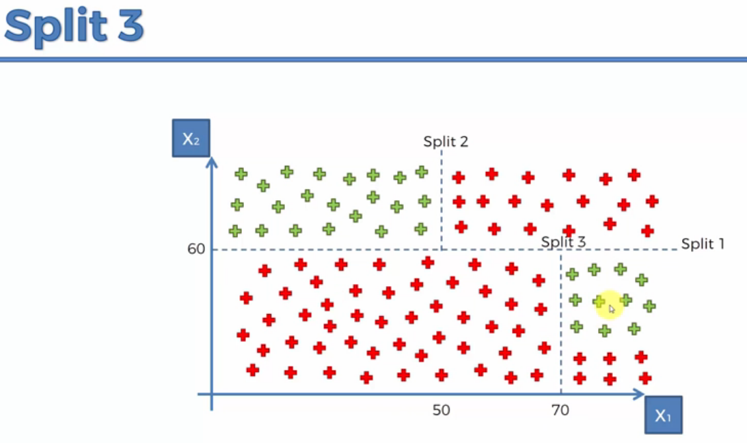
Classification Trees

Slide 11
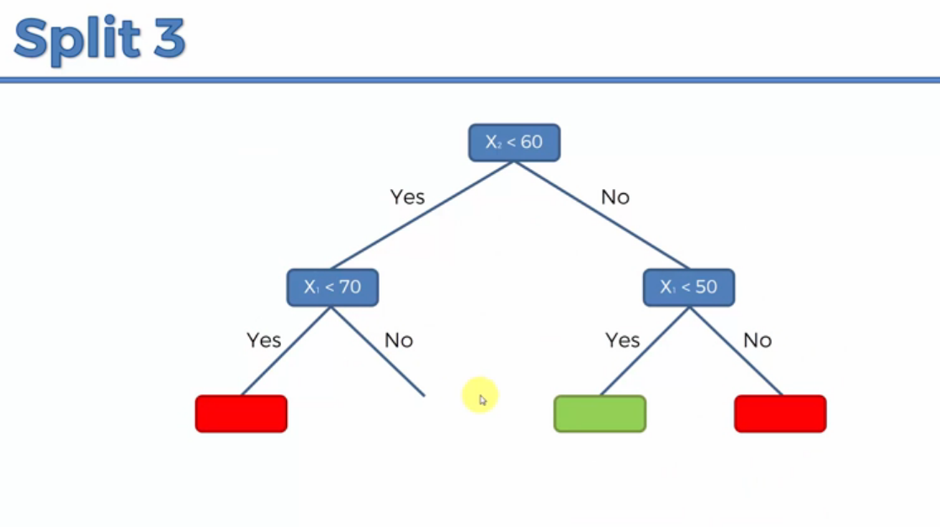
Classification Trees

Slide 12
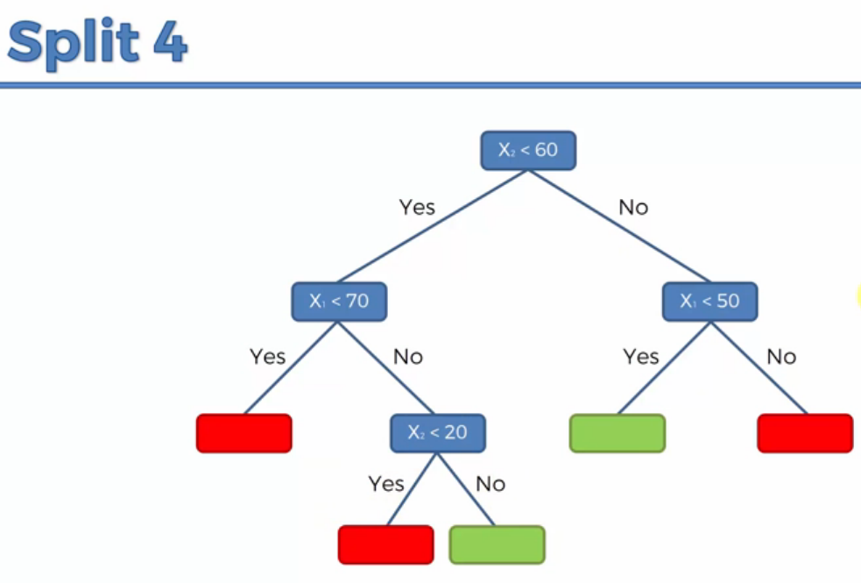
Classification Trees

Slide 13
Decision Trees
Old methods
Reborn with upgrades
Random Forest
Gradient Boosting etc.

